Slide 1
ASP. Net Core conversion project update for TSPWeb
DHS Color Palette Per OPA RGB Colors
Use Arial Font For All Text
Change Presenter’s Name
And Date in Slide Master
Notes:
Change Presenter’s Name and Date in Slide Master view.

Slide 2
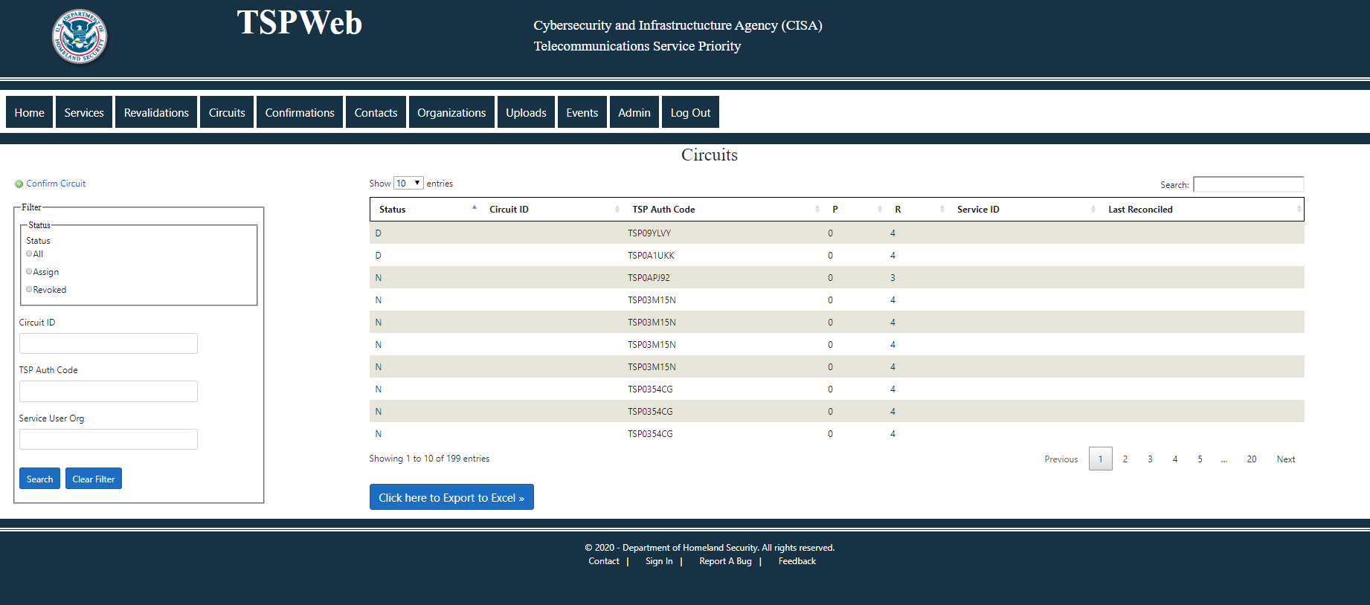
Work Completed
Reading table data
Screen layout for all Module have been completed
(Services, Revalidation, Circuits, Confirmation, Organization, Uploads, Events)

Slide 3
Work Completed
Reading table data
Parts of screen
Filter – Select tables data to be displayed
Create Read Update Delete Buttons – Functionality to edit and display records in the in the data base.
Table data – Subset of data in the data base.
F

Slide 4
The DHS signature may be displayed alone on a slide to cue the speaker that they have reached the end of the presentation.
If a question and answer session follows the presentation, this slide can be projected during this time.

